Slide 1

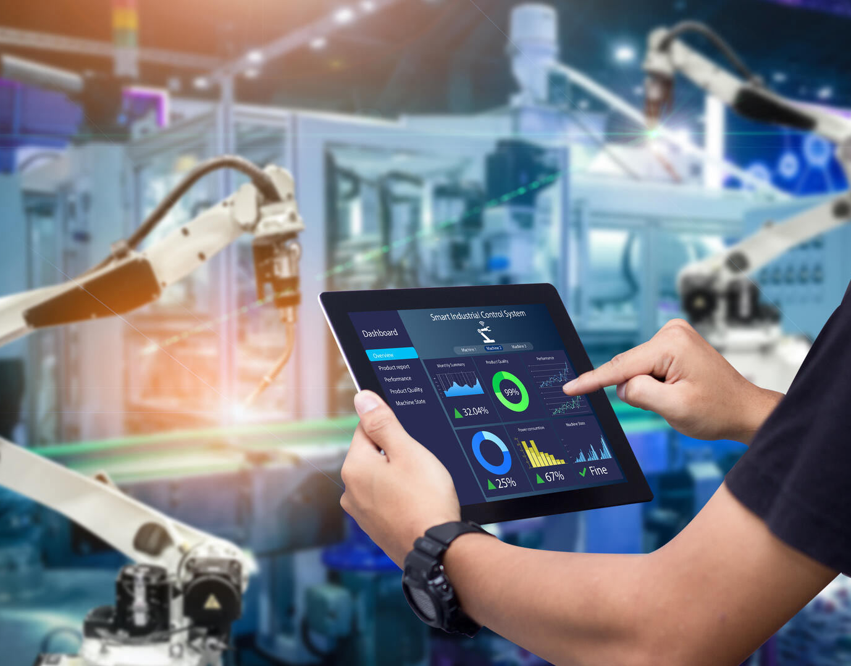
Team AutoVation
ScreenCraft’24
Aritra Ghosh, 23BEE0031
Ayan Sen, 23BEE0034
Soumyajit Sarkar, 23BEE0028

Slide 2
Problem Statement
Develop a versatile compound object(s) which are innovative designs, creative concept. Develop in a reusable for reuse across various machines and industries.

Slide 3
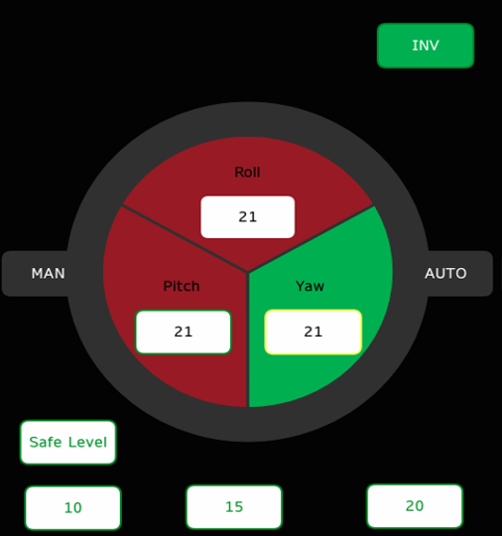
Our Solution : AxesNav
AxesNav is a versatile and reusable compound object which is able to measure the data for 3-axes monitoring.
Commonly used 3-axes systems are :
Cartesian (X,Y,Z)
Roll, Yaw, Pitch
Magnetic Field (Bx, By, Bz)
Geodetic Coordinate System (Latitude, Longitude, Elevation)
Gimbal (Pan, Tilt, Roll)

Slide 4
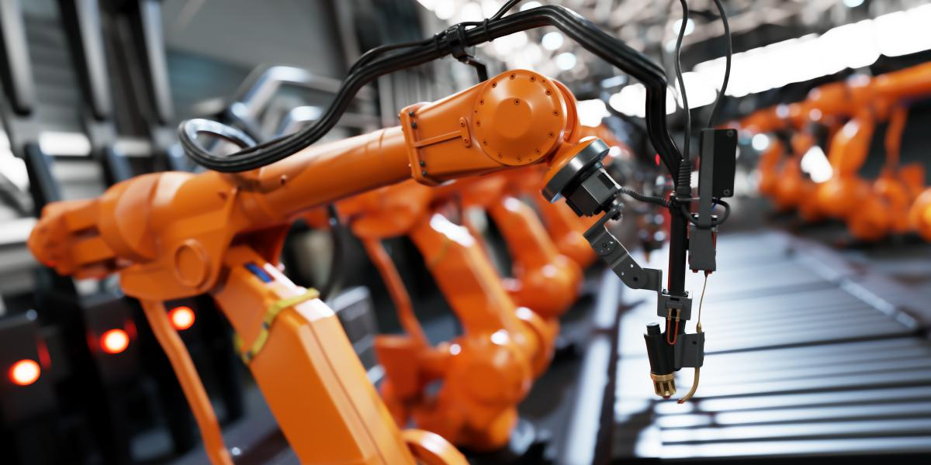
WHY monitor axial parameters ?
Axial faults in automation and mobility have resulted in many fatal damages
An axis fault occurs when the robotic arm or a specific joint malfunctions, leading to inaccurate positioning, misalignment, or failed movements.
This can result in accidents, damage to components, or even injury to humans nearby.

Slide 5
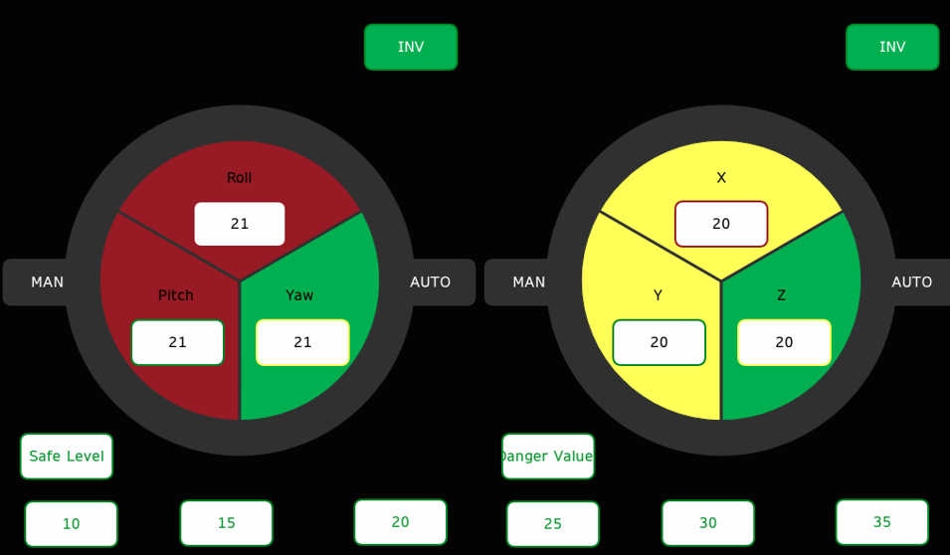
Our Solution : AxesNav

Slide 6
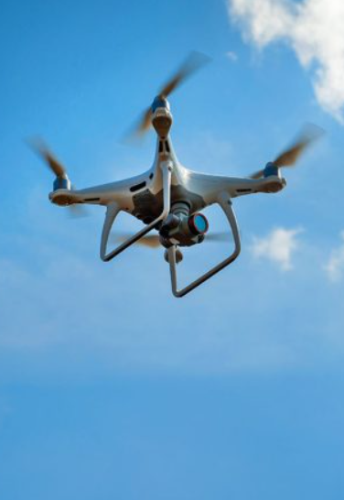
Versatile Use in Multiple Sectors
Three axes monitoring system has various uses:
Application in aerial systems like drones, aeroplanes.
Use in autonomous vehicles and robotics in warehouses.
Monitoring for submarines and underwater equipment.
Notes:
Mining and Construction
Agriculture Purpose
Defense and Military
Marine and Offshore

Slide 7
PROJECT DETAILS
Our project incorporates Schneider Electric’s EcoStruxure terminal Operator’s capability to create Compound Objects for HMI system
FUNCTIONALITY:
USER EXPERIENCE:
3 parameters of a system can be monitored simultaneously.
3 level visual safety warning with respect to set values.
Auto to Manual operation switching option.
Emergency system shutdown enabled.
Easy to use 3 panel system.
Easy to understand safety warnings with green as safe, yellow as caution and red as hazardous.
Digital output enables easy readability.

Slide 8
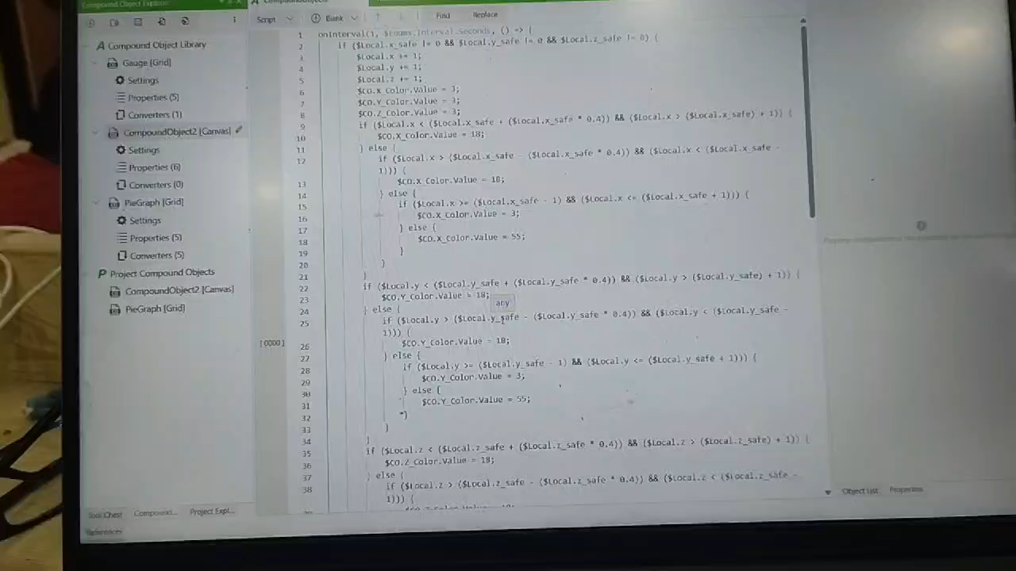
BUG DETECTED

Slide 9
DEMO

